Slide 1


Slide 2
Database Management Systems
Week 1, Day 1
Types of Databases and DBMS Software Overview
Atta Muhammad
+92-333-1971110
attapanhyar@quest.edu.pk

Slide 3

Types of Databases - Overview
Relational Databases (RDBMS):
Structured data stored in tables.
Use SQL for data manipulation.
Examples: MySQL, PostgreSQL, SQL Server, Oracle.
NoSQL Databases:
Designed for unstructured or semi-structured data.
Types: Document-based, Key-Value, Columnar, Graph databases.
Examples: MongoDB, Cassandra, Redis.
Object-Oriented Databases:
Data represented as objects (similar to OOP).
Supports Compex data relationships.
Examples: db4o, ObjectDB.

Slide 4
Relational Databases (RDBMS)
Key Features:
Tables with rows (records) and columns (fields).
Primary and foreign keys to maintain relationships.
Supports ACID properties.

Slide 5
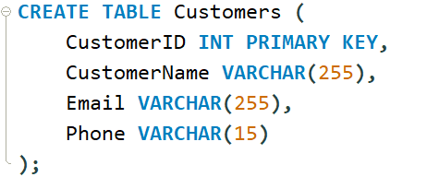
Relational Databases (RDBMS)

Slide 6
NoSQL Databases
Key Characteristics:
Flexible schema design.
Horizontal scalability for large-scale data.
Ideal for Big Data and real-time web applications.
Use Cases:
Social media, IoT, real-time analytics

Slide 7
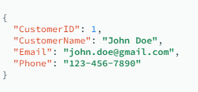
Example

Slide 8
Object-Oriented Databases
Advantages:
Seamless integration with object-oriented programming.
Handles complex data types like multimedia.

Slide 9
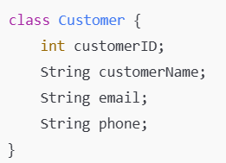
Example (Java)

Slide 10
Overview of DBMS Software
MySQL:
Open-source, widely used in web applications.
Example
PostgreSQL:
Advanced open-source RDBMS with support for JSON.

Slide 11
DBMS Software Continued
SQL Server:
Developed by Microsoft; supports enterprise applications.
Oracle:
Enterprise-grade with extensive features.

Slide 12
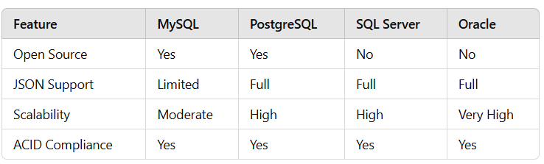
Comparison of DBMS Software

Slide 13
Summary
Key Points:
Relational, NoSQL, and Object-Oriented databases serve different needs.
DBMS software like MySQL, PostgreSQL, SQL Server, and Oracle are versatile tools.
Hands-on practice with SQL is a crucial for understanding.

Slide 14
Question

